Slide 1
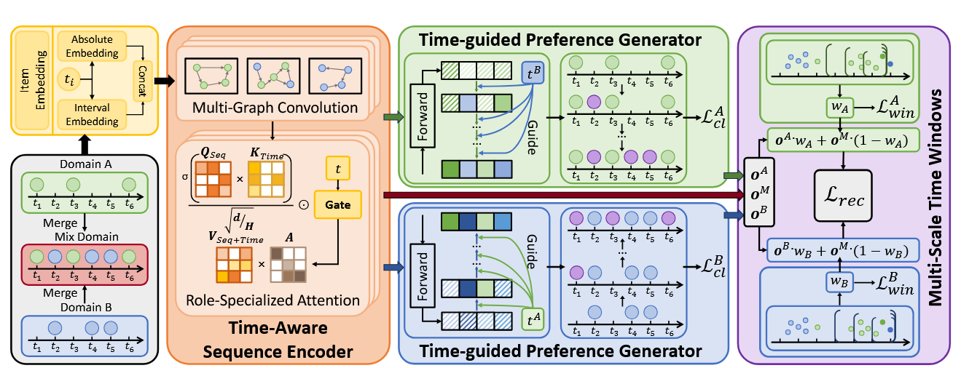
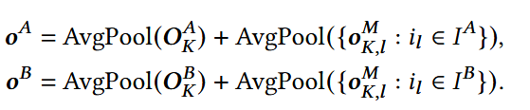




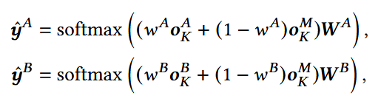
创新点：
1.构建补全域，将a域与b域中存在可补全情况进行补全，得到三个域。再加入绝对时间与相对时间，学习一个更好的item embedding表示。
2.扩散的输入：通过对两个缺失域进行平均池化得到用户偏好。前向过程进行加噪，反向过程引入一个b时间条件，用b域交互的时间戳得到一个embedding，去引导a域扩散得到最后去噪以后的user embedding再与a域所有item进行点积，来得到可能在这个时间的item，然后选top1补全。
3.补全a域以后，计算一个平均池化与之前的user偏好进行对比学习。b域一样进行。
4.预测a域的下一个时，根据时间t计算三个窗口，来评估交互密度，来评估a域可信度权重，然后构造预测下一个item
2026_WWW_TA-CDSR_A Time aware Framework for Cross Domain Sequential Recommendation

Slide 2
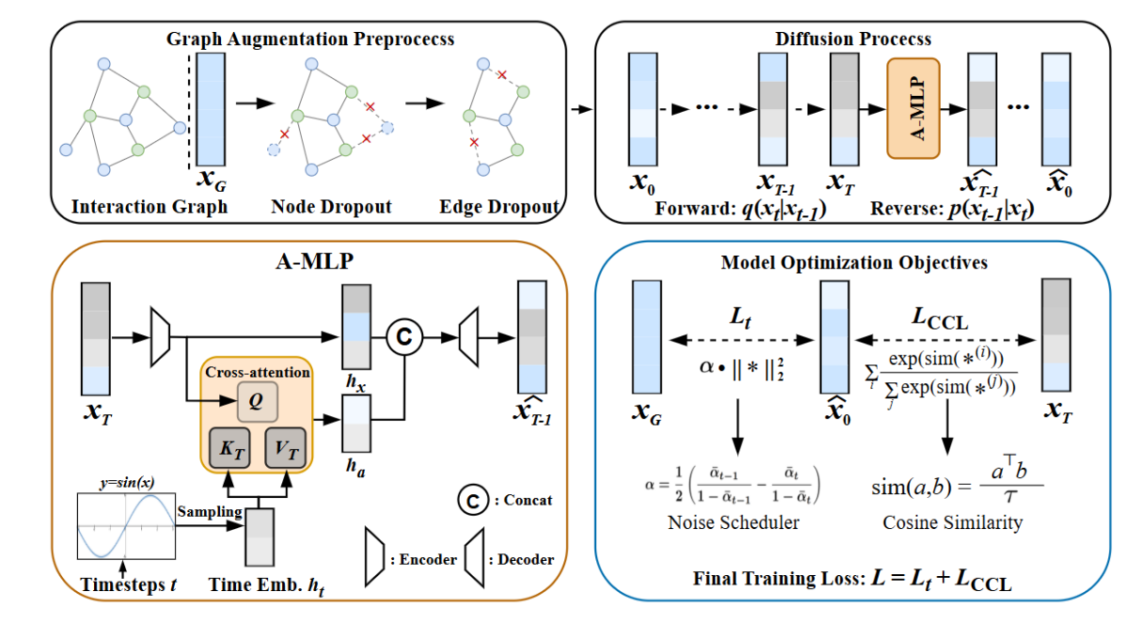

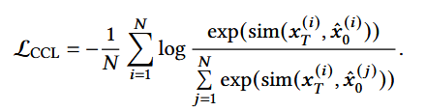


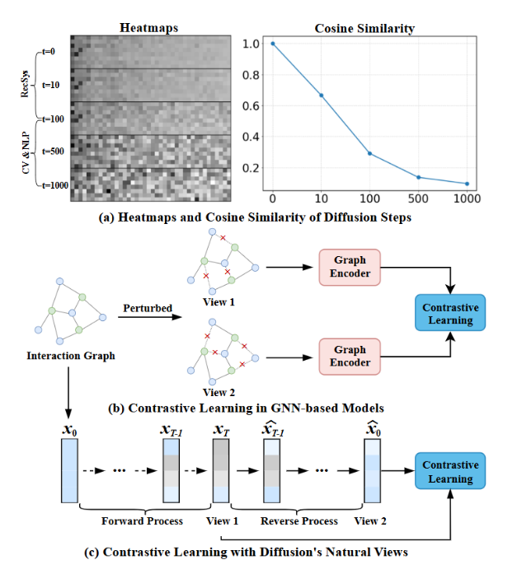
动机：
传统图对比学习通常通过节点/边随机 dropout 等人工增强构造两个视图，再做对比学习；而这篇作者发现，在推荐场景的浅扩散过程中，不同加噪时间步的表示本身仍然保留用户偏好的语义信息，因此扩散过程天然就能产生语义相关的视图；于是他把最强噪声状态 xT当作一个视图，把去噪输出 x^0当作另一个视图，用它们来做对比学习，从而学习更稳定的用户表示。
创新点：
1.传统的图对比学习随机剪枝，转化成了利用扩散模型得到图对比学习所需要的数据。
2026_WWW_CCL-Diff_Representation-Consistent Diffusion with Intrinsic Contrastive Learning for Recommender Systems

Slide 3
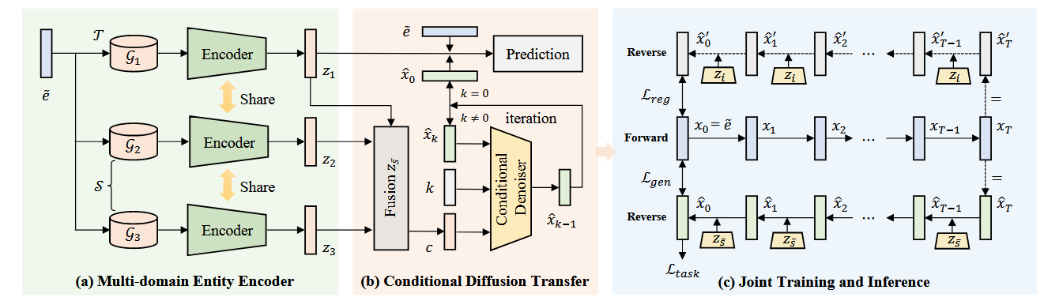





动机：
1.单个域进行知识图谱补全，效果不佳；
使用其他域进行辅助补全，需考虑域之间的空间与语义本身不一致的问题。作者使用扩散模型得到一个更完整、通用的表示。
创新点：
1.当某个域信息过强时，MLP 训练容易只依赖这个域，导致其他域学得很差，推理时弱域表现不稳定，所以引入单域约束，让每个域都能独立学习目标表示，从而保证融合表示均衡且泛化可靠。
2026_WWW_DMKGC_Conditional Diffusion Guided Knowledge Transfer for Multi-Domain Knowledge Graph Completion

Slide 4
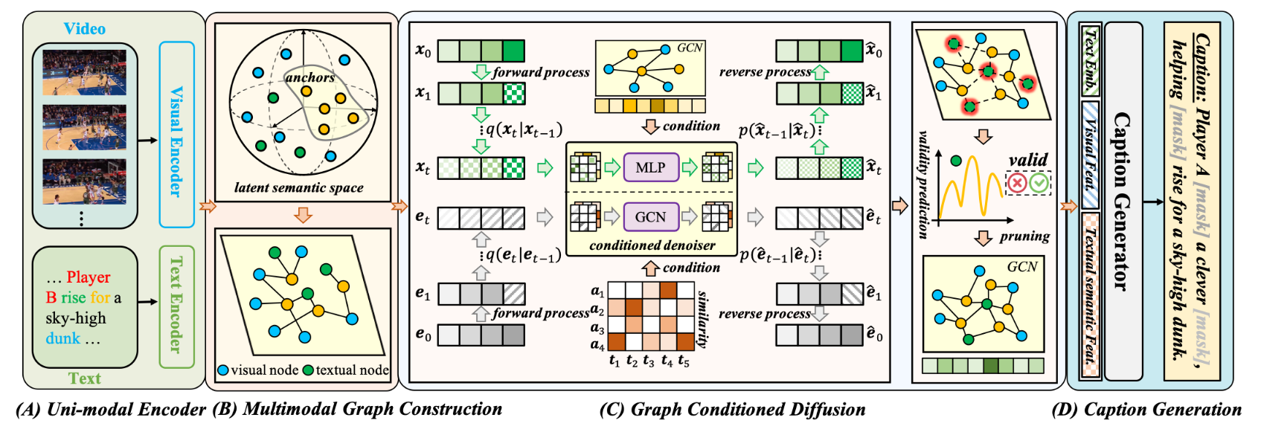
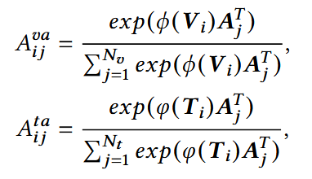






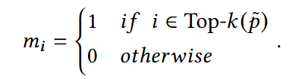
动机：
1.以前的方法大多在提升“看视频”的能力，但 captioning 还需要提升“把看到的内容准确说出来”的能力。这个“看到”和“说出来”之间的语义映射没有建好，就会导致模型对多模态信息理解不完整，最终生成的字幕不够准确。
创新点：
1.在多模态对齐时，引入一个anchor节点，来间接对于两个模态。将两个模态对齐于一个语义空间，然后每个边都有权重。（类似于codebook）
2.扩散模型去预测缺失的text与text-anchor权重。
2026_WWW_MGCDVc_Multimodal Graph Conditioned Diffusion Model for Video Captioning

Slide 5



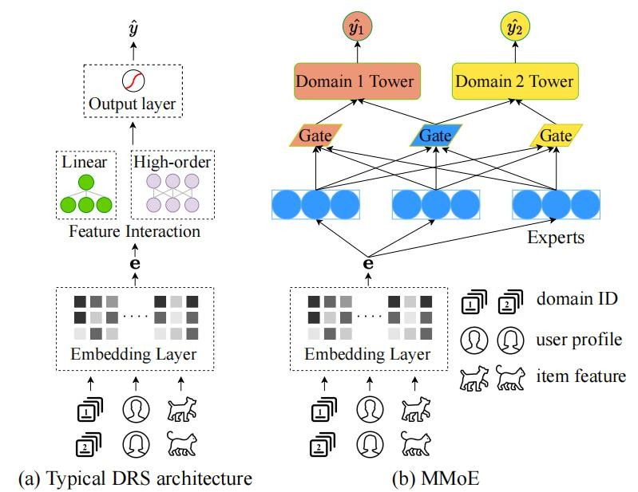
A T A I
Advanced Technique of Artificial Intelligence
Chongqing University A T A I
_{of Technology} Advanced Technique of
Artificial Intelligence
Chongqing University of Technology
Method
Code:https://github.com/mindspore-lab/models/tree/master/research/huawei-noah/Diff-MSR https://github.com/Applied-Machine-Learning-Lab/Diff-MSR
2024_WSDM_Diff-MSR：A Diffusion Model Enhanced Paradigm for Cold-Start Multi-Scenario Recommendation

Slide 6
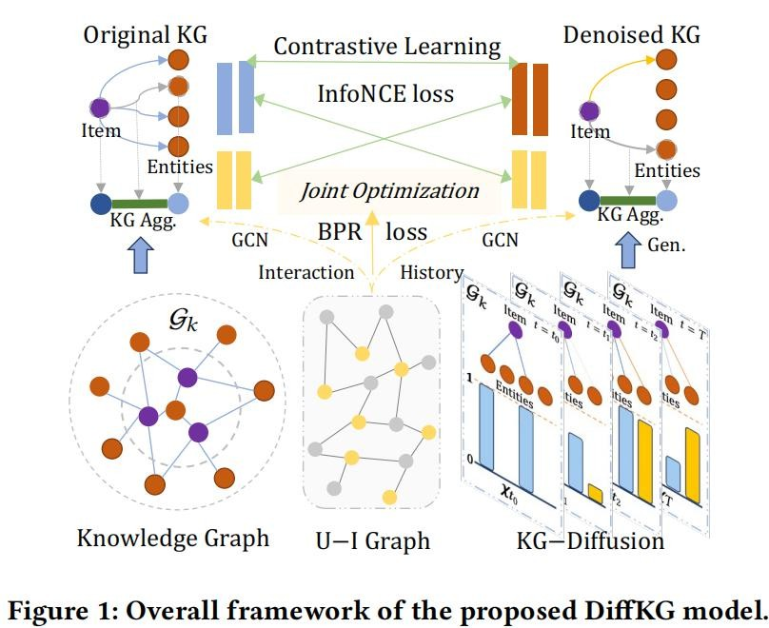
A T A I
Advanced Technique of Artificial Intelligence
Chongqing University A T A I
_{of Technology} Advanced Technique of
Artificial Intelligence
Chongqing University of Technology
Method
Code:https://github.com/HKUDS/DiffKG 2024_WSDM_DiffKG：Knowledge Graph Diffusion Model for Recommendation

Slide 7
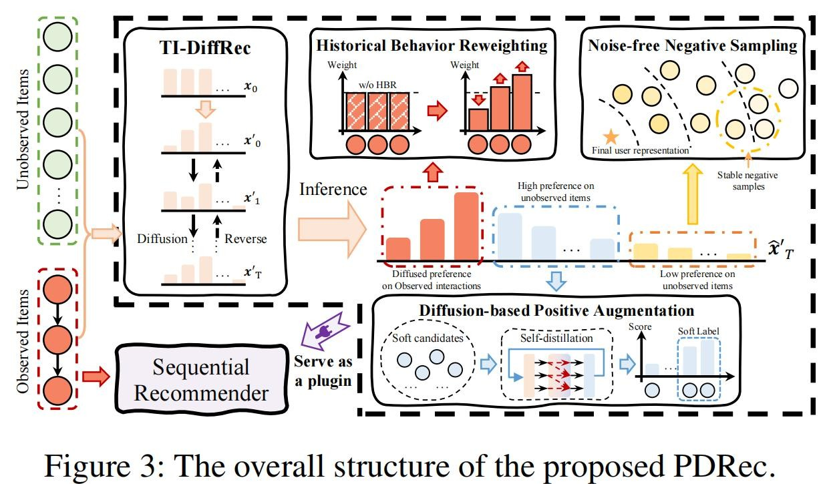
A T A I
Advanced Technique of Artificial Intelligence
Chongqing University A T A I
_{of Technology} Advanced Technique of
Artificial Intelligence
Chongqing University of Technology
Method
Code:https://github.com/hulkima/PDRec 2024_AAAI_Plug-in Diffusion Model for Sequential Recommendation

Slide 8
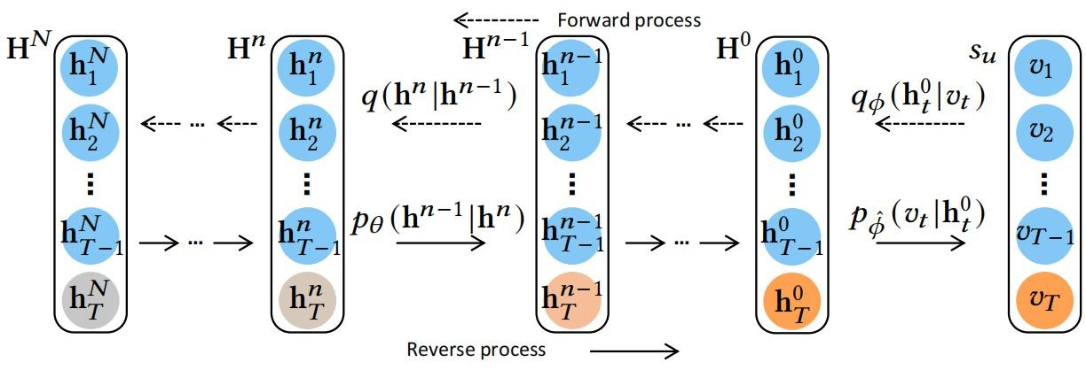
A T A I
Advanced Technique of Artificial Intelligence
Chongqing University A T A I
_{of Technology} Advanced Technique of
Artificial Intelligence
Chongqing University of Technology
Method
2023_o_Sequential Recommendation with Diffusion Models

Slide 9
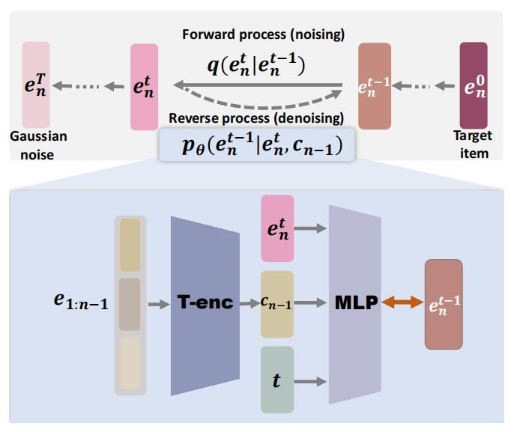
A T A I
Advanced Technique of Artificial Intelligence
Chongqing University A T A I
_{of Technology} Advanced Technique of
Artificial Intelligence
Chongqing University of Technology
Method
Code:https://github.com/YangZhengyi98/DreamRec
2023_NeurIPS_generate-what-you-prefer-reshaping-sequential-recommendation-via-guided-diffusion-Paper-Conference

Slide 10
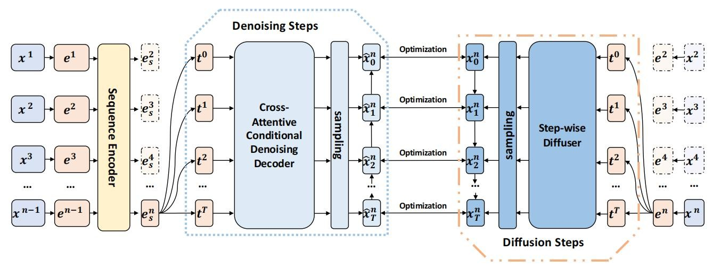
A T A I
Advanced Technique of Artificial Intelligence
Chongqing University A T A I
_{of Technology} Advanced Technique of
Artificial Intelligence
Chongqing University of Technology
Method
2023_Conditional Denoising Diffusion for Sequential Recommendation

Slide 11
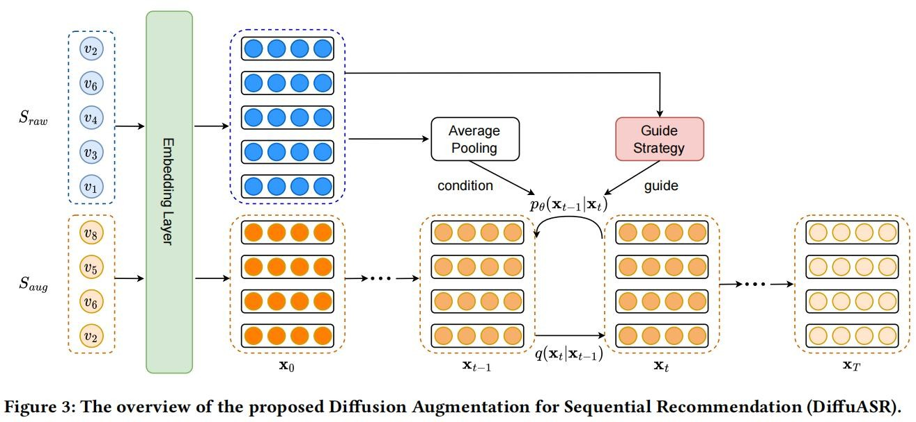
A T A I
Advanced Technique of Artificial Intelligence
Chongqing University A T A I
_{of Technology} Advanced Technique of
Artificial Intelligence
Chongqing University of Technology
Method
Code:https://github.com/liuqidong07/DiffuASR https://gitee.com/mindspore/models/tree/master/research/recommend/DiffuASR
2023_CIKM_Diffusion Augmentation for Sequential Recommendation

Slide 12
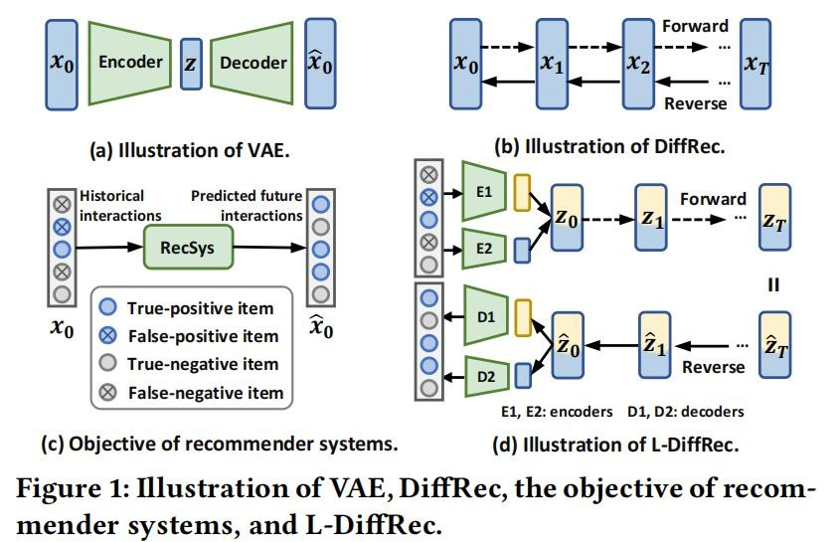
A T A I
Advanced Technique of Artificial Intelligence
Chongqing University A T A I
_{of Technology} Advanced Technique of
Artificial Intelligence
Chongqing University of Technology
Method
2023_ACM_Diffusion Recommender Model

Slide 13
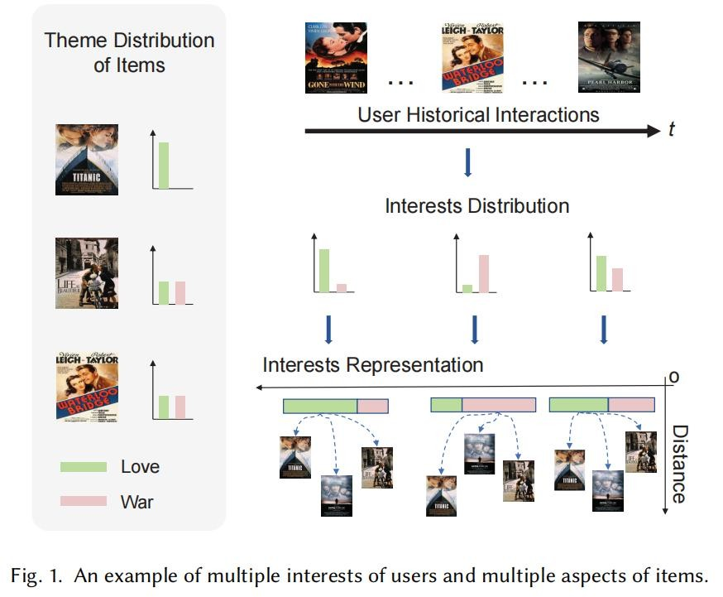
A T A I
Advanced Technique of Artificial Intelligence
Chongqing University A T A I
_{of Technology} Advanced Technique of
Artificial Intelligence
Chongqing University of Technology
Method
Code:https://github.com/WHUIR/DiffuRec 2023_ACM_DiffuRec：A Diffusion Model for Sequential Recommendation

Slide 14
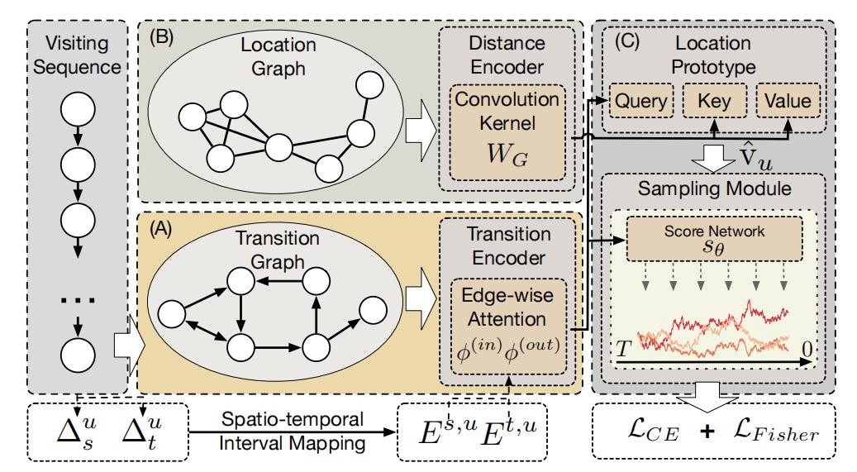
A T A I
Advanced Technique of Artificial Intelligence
Chongqing University A T A I
_{of Technology} Advanced Technique of
Artificial Intelligence
Chongqing University of Technology
Method
Code:https://github.com/Yifang-Qin/Diff-POI.
2023_ACM_A Diffusion model for POI recommendation

Slide 15
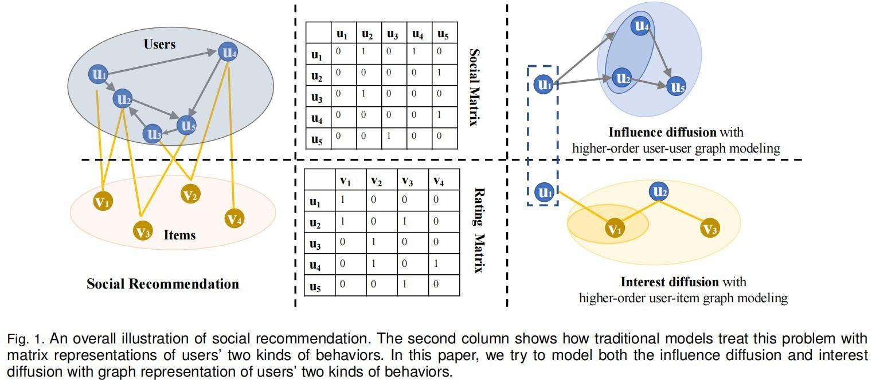
A T A I
Advanced Technique of Artificial Intelligence
Chongqing University A T A I
_{of Technology} Advanced Technique of
Artificial Intelligence
Chongqing University of Technology
Method
Code:https://github.com/PeiJieSun/diffnet
2021_IEEE_DiffNet++： A Neural Influence and Interest Diffusion Network for Social Recommendation

Slide 16
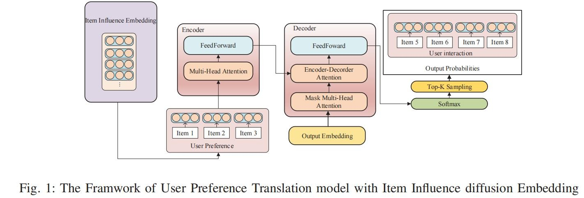
A T A I
Advanced Technique of Artificial Intelligence
Chongqing University A T A I
_{of Technology} Advanced Technique of
Artificial Intelligence
Chongqing University of Technology
Method
2020_ASONAM_User Preference Translation Model for Recommendation System with Item Influence Diffusion Embedding

Slide 17
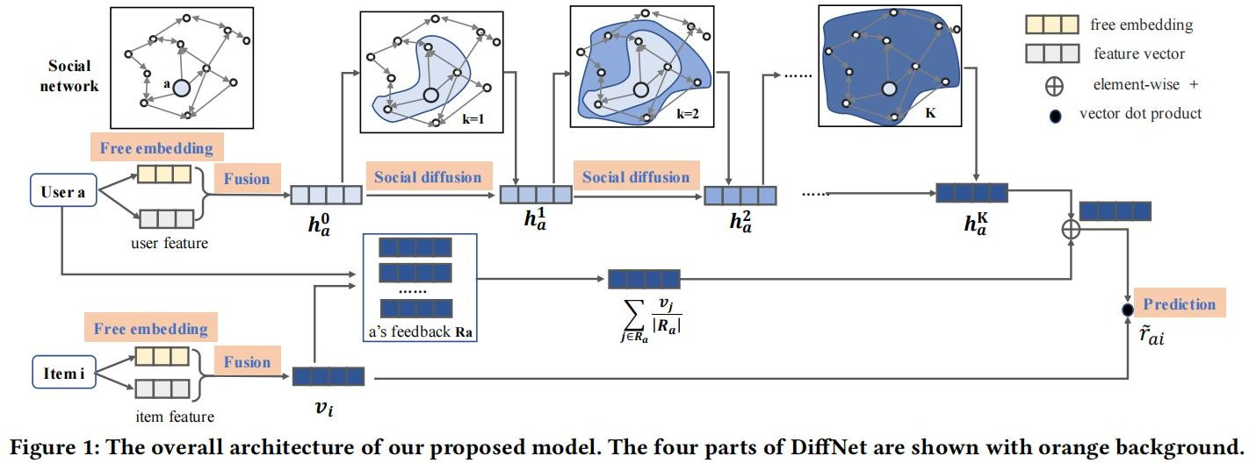
A T A I
Advanced Technique of Artificial Intelligence
Chongqing University A T A I
_{of Technology} Advanced Technique of
Artificial Intelligence
Chongqing University of Technology
Method
2019_SIGIR_A Neural Influence Diffusion Model for Social Recommendation code: https://github.com/PeiJieSun/diffnet

Slide 18

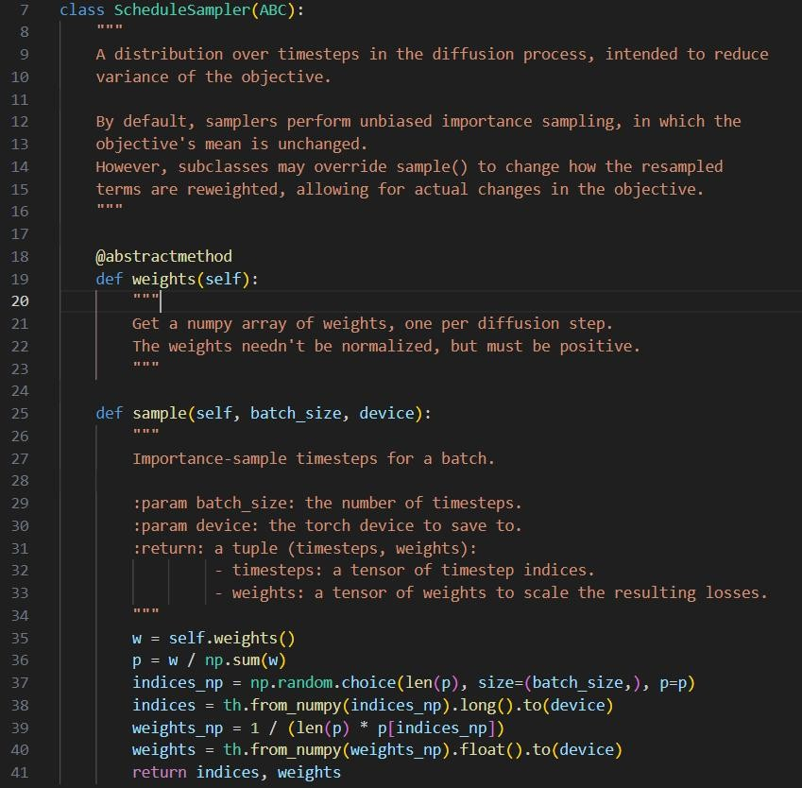
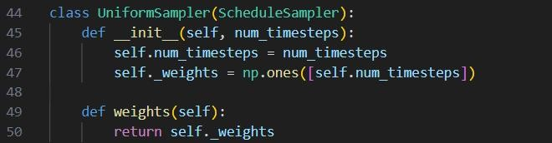
Code:A Diffusion Model for Sequential Recommendation
A T A I
Advanced Technique of Artificial Intelligence
Chongqing University A T A I
_{of Technology} Advanced Technique of
Artificial Intelligence
Chongqing University of Technology
step_sample.py

Slide 19
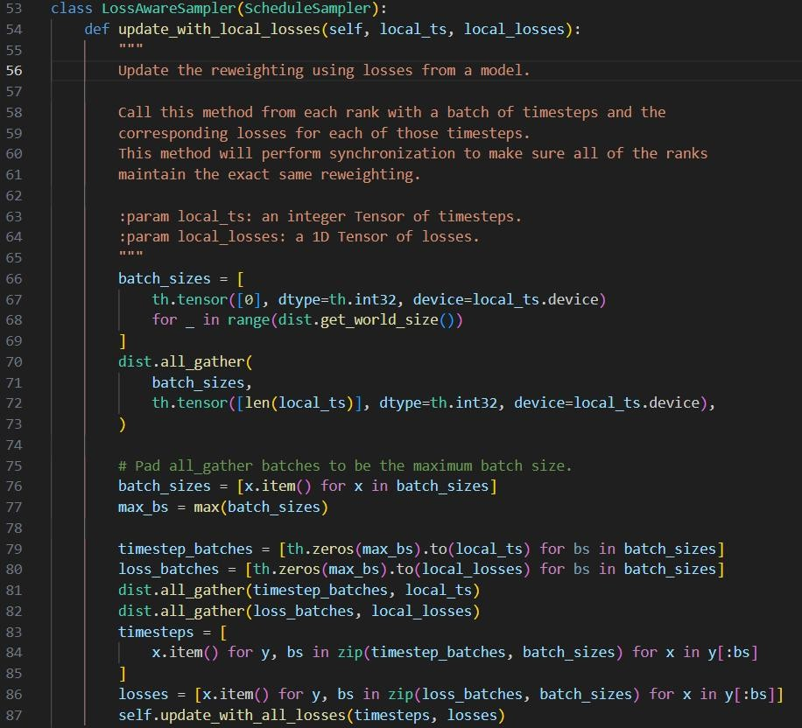
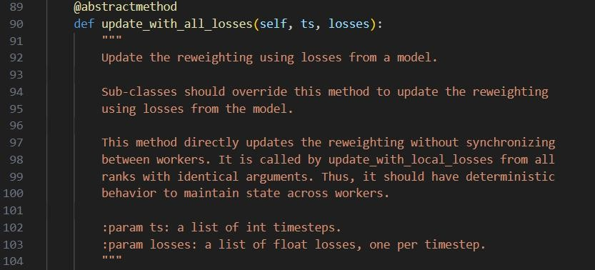
Code:A Diffusion Model for Sequential Recommendation
A T A I
Advanced Technique of Artificial Intelligence
Chongqing University A T A I
_{of Technology} Advanced Technique of
Artificial Intelligence
Chongqing University of Technology
step_sample.py

Slide 20
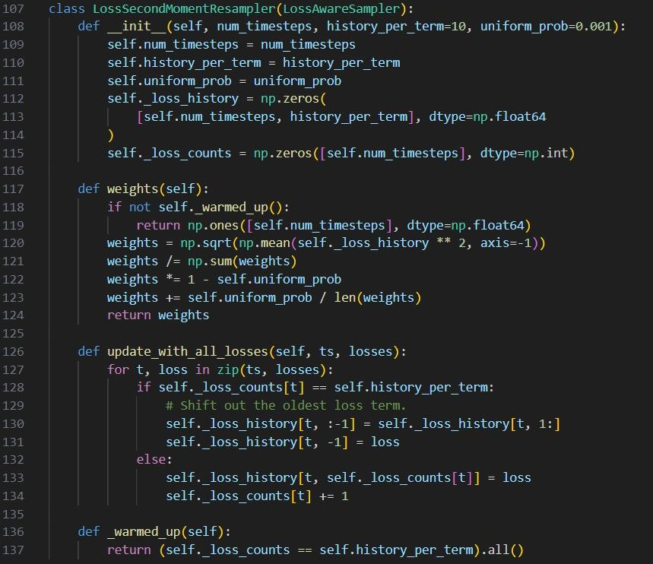
A T A I
Advanced Technique of Artificial Intelligence
Chongqing University A T A I
_{of Technology} Advanced Technique of
Artificial Intelligence
Chongqing University of Technology
Code:A Diffusion Model for Sequential Recommendation
step_sample.py

Slide 21
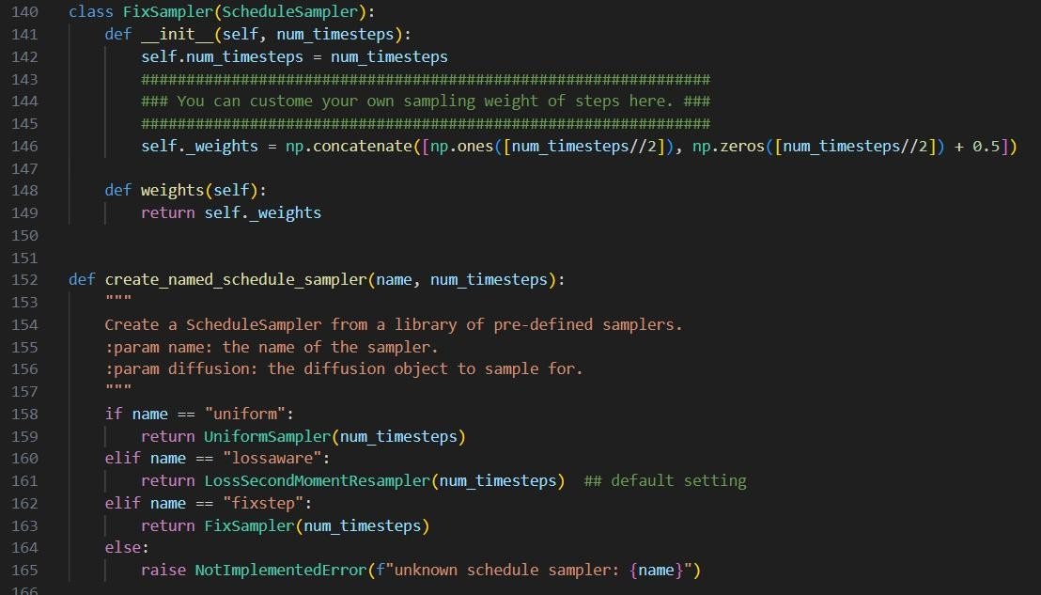
A T A I
Advanced Technique of Artificial Intelligence
Chongqing University A T A I
_{of Technology} Advanced Technique of
Artificial Intelligence
Chongqing University of Technology
Code:A Diffusion Model for Sequential Recommendation
step_sample.py

Slide 22
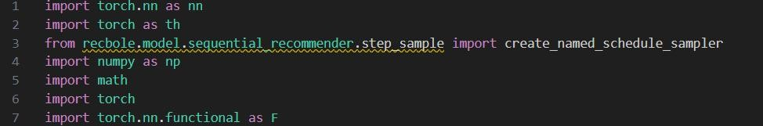
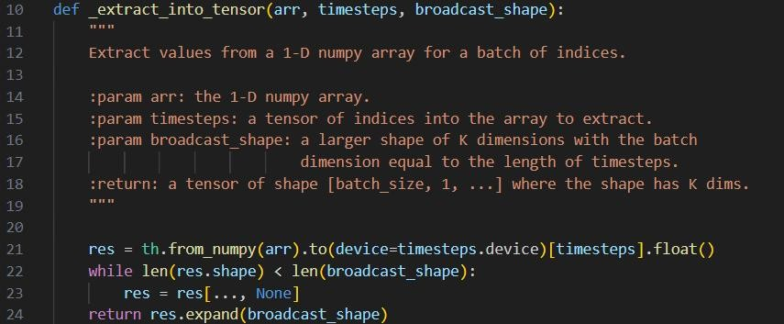
A T A I
Advanced Technique of Artificial Intelligence
Chongqing University A T A I
_{of Technology} Advanced Technique of
Artificial Intelligence
Chongqing University of Technology
Code:A Diffusion Model for Sequential Recommendation
diffurec.py

Slide 23
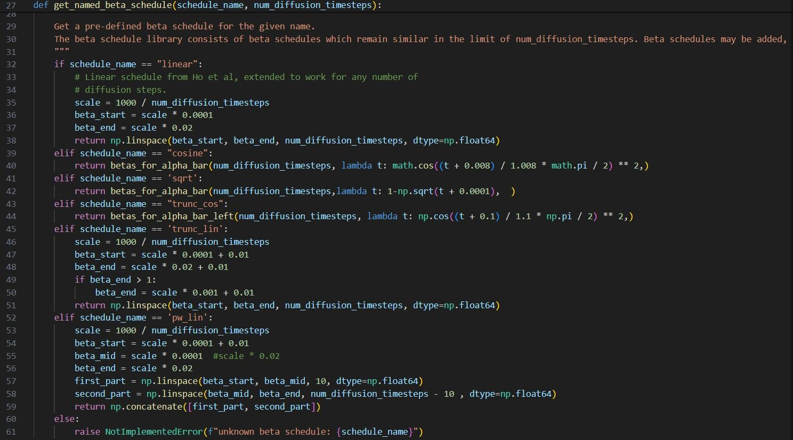
Code:A Diffusion Model for Sequential Recommendation
A T A I
Advanced Technique of Artificial Intelligence
Chongqing University A T A I
_{of Technology} Advanced Technique of
Artificial Intelligence
Chongqing University of Technology
diffurec.py

Slide 24
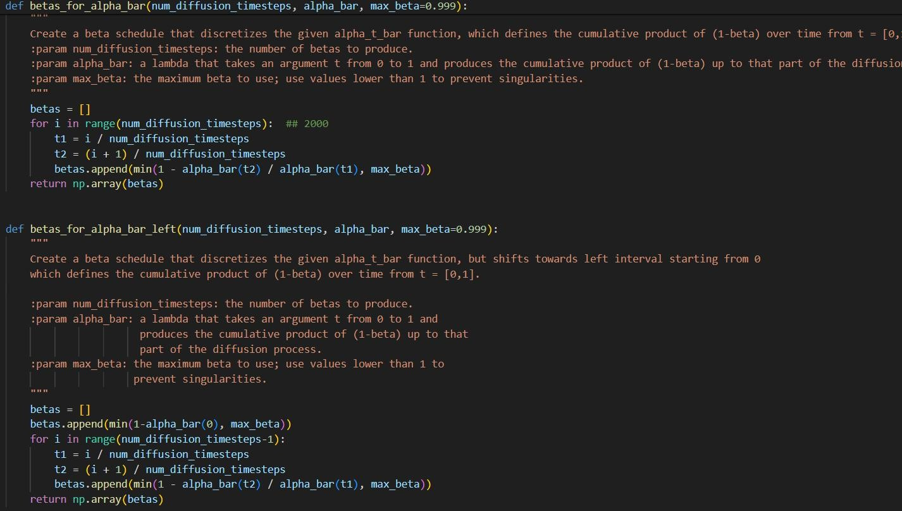
Code:A Diffusion Model for Sequential Recommendation
A T A I
Advanced Technique of Artificial Intelligence
Chongqing University A T A I
_{of Technology} Advanced Technique of
Artificial Intelligence
Chongqing University of Technology
diffurec.py

Slide 25
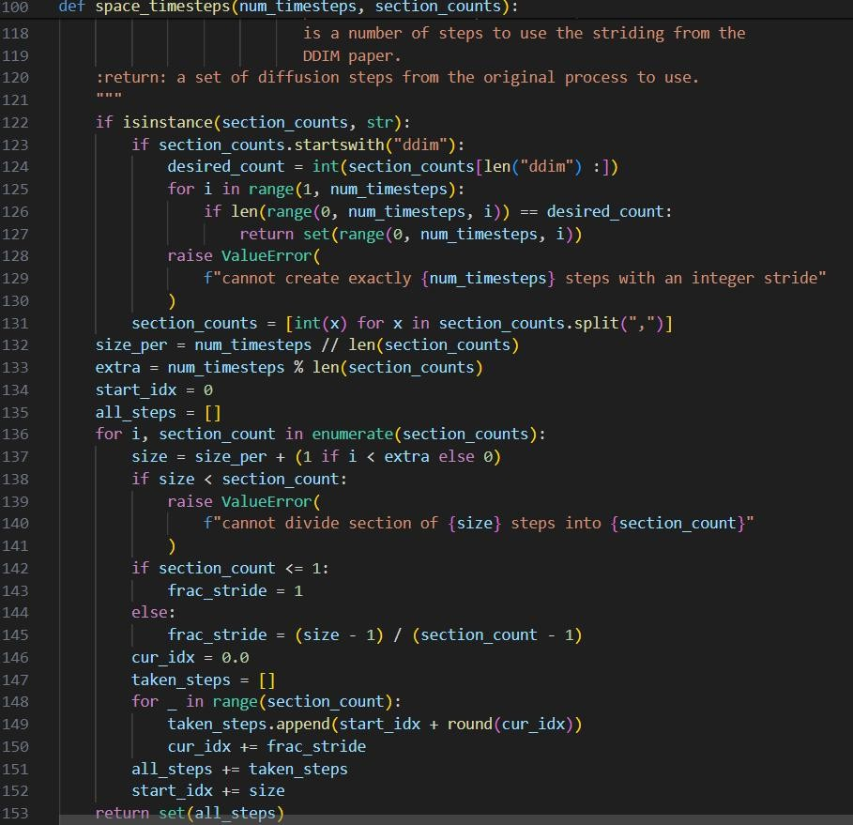
tial Recommendation
A T A I
Advanced Technique of Artificial Intelligence
Chongqing University A T A I
_{of Technology} Advanced Technique of
Artificial Intelligence
Chongqing University
of Technology Code:A Diffusion Model for Sequen
diffurec.py
详细代码：
https://github.com/WHUIR/DiffuRec
文件：diffurec.py

Slide 26
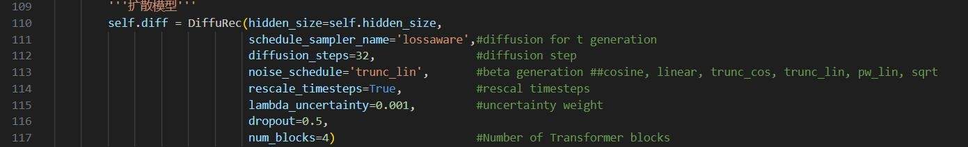
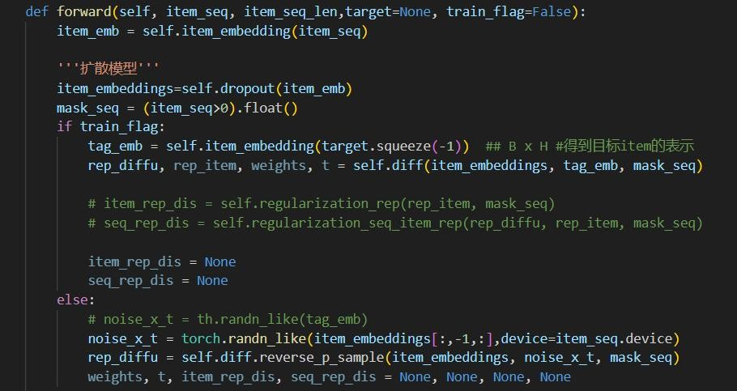
Code:A Diffusion Model for Sequential Recommendation
A T A I
Advanced Technique of Artificial Intelligence
Chongqing University A T A I
_{of Technology} Advanced Technique of
Artificial Intelligence
Chongqing University of Technology
示例代码
输入：[batch_size,seq_len,hiddensize]输出：[batch_size,hiddensize]
输入为初始的item的 Embedding([batch_size,seq_len,hiddensize])以及标签embedding([batch_size,hiddensize])，输入标签是想加入与标签类似的正态分布噪音，在训练时候加入，在测试时使用随机生成的噪音。最终模型的输出可直接用来预测推荐序列。

Slide 27
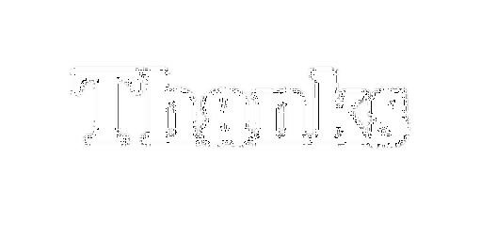

Thanks
Chongqing University A T A I
_{of Technology} Advanced Technique of
Artificial Intelligence
Chongqing University of Technology

